Slide 2
Packback is an AI-supported online discussion platform for developing critical thinking, curiosity, and writing skills.
Student Feedback
Spring 2019 Student Feedback Survey
“In past classes where Packback wasn’t used, I wasn’t all that interested in the material. I just did what I had to do to pass the class. I didn’t think I’d care about a GenEd ever before Packback.”

Slide 3
Critical questioning skills are essential to college and post-grad life:
In asking effective questions while interviewing to select the right job after graduation.
In identifying opportunities for innovation, when starting a business, or working within a team.
In learning new skills independently after graduation, to keep adapting to a changing world!

Slide 4
Our specific Packback course objectives
In this class we’re using Packback to:
[Insert your specific course objectives for using Packback here]
[Insert your specific course objectives for using Packback here]
[Insert your specific course objectives for using Packback here]

Slide 5
How Packback discussion fits into this course
Packback will be used
in this course as a way
to integrate and apply
course concepts.
Remembering new factual information and course concepts.
Course Lecture
Mastery of Course Objectives
Analyzing, Evaluating, and Generating discussion into broader contexts.
Proving Understanding of course information and concepts.
Packback
Quizzes & Tests

Slide 6
Participation requirements
& how you will be graded

Slide 7
Packback is worth
[10%] of your final grade!
This is an important assignment, please take it seriously as it will affect your final grade.

Slide 8
Participation requirements
Weekly Deadline
[Monday] at [11:59 PM]
What to Post per deadline period
Post 1 Question
Post 2 Responses (Your choice of a Response, Counterpoint, or Supporting point)
Other Expectations
[Posts must have a minimum Curiosity Score of 50]
[Partial Credit / No Partial Credit]

Slide 9
Packback’s AI &
how to check your grade

Slide 10
Posts on Packback are reviewed by AI
Packback’s AI
Packback’s AI “flags” posts that may be violating community guidelines.
Posts are then reviewed by Packback moderators.
Offending posts are moderated and no longer count for credit until they are re-published.
Packback’s AI flags for:
Plagiarism
Closed Ended Questions (e.g. “What is the definition of mitosis?”)
Class Logistics Posts (e.g. “When is the next test?”)
Low Effort/Low Detail Posts

Slide 11
What happens if your post is moderated?
Post is “Flagged”
If your post is “Flagged”, you have not yet lost points!
At this time, your post is still published and still counts for credit.
Post is “Moderated”
If your post is moderated, it is unpublished and no longer counts for credit.
If your post is “Moderated”, you receive an email notifying you.
Post is “Republished”
From the email, you can “edit & re-publish” the post.
Doing so will earn back your points for the post without penalty, so long as you edit before grades are entered.

Slide 12
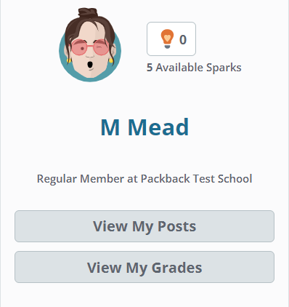
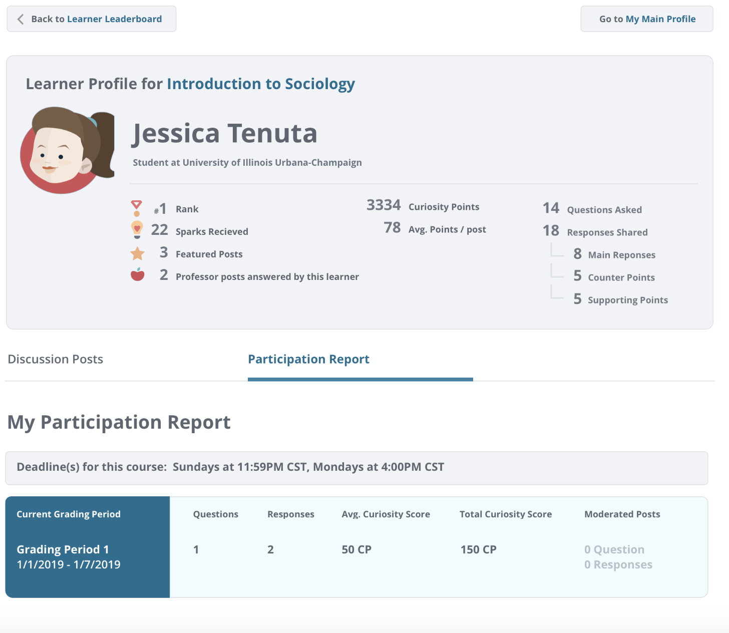
Track your participation
Your Name
You can check your current participation by deadline period to make sure you’ve earned your full points for the week.
Note: If you have any moderated posts, you can track them here!
Your Name

Slide 13
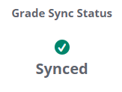
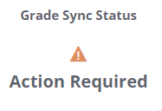
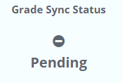
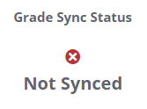
You are responsible for your gradebook sync!
What do the “Grade Sync Status” symbols mean?
Your grade has successfully synced! No further action required.
How do you check?
1. GO HERE!
You have not yet synced your gradebook. Please click the correlating assignment in your LMS
2. THEN HERE!
Your grade has successfully synced! It will update when the next deadline falls.
Your Name
Email help@packback.co for assistance

Slide 14
How to send my Packback grade to the Canvas gradebook?
Only access Packback via Canvas to activate the grade transfer process:
Go to your course on Canvas
2. Click the link for a Packback assignment you want to sync.
3. Allow Packback to load so you see the community feed. You may need to click “Load Packback in a new tab.”
For your grade to transfer from Packback to Canvas you must do this for each assignment. You can still activate the assignment if the deadline is passed.
Questions?
If you have any issues getting your grade to transfer to Canvas, please email help@packback.co

Slide 15
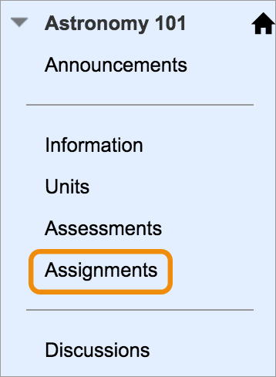
How to send my Packback grade to the Blackboard gradebook?
Only access Packback via Blackboard to activate the grade transfer process:
Go to your course on Blackboard
2. Click the link for a Packback assignment you want to sync.
3. Allow Packback to load so you see the community feed.
For your grade to transfer from Packback to Blackboard you must do this for each assignment. You can still activate the assignment if the deadline is passed.
Questions?
If you have any issues getting your grade to transfer to Blackboard, please email help@packback.co

Slide 16
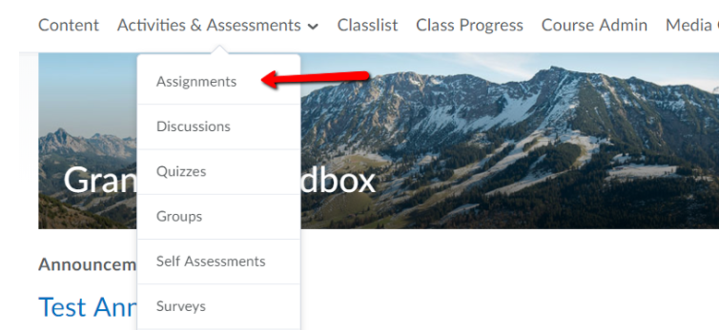
How to send my Packback grade to the D2L/Brightspace gradebook?
Only access Packback via D2L/Brightspace to activate the grade transfer process:
Go to your course on D2L Brightspace
2. Click the link for a Packback assignment.
3. Allow Packback to load so you see the community feed.
For your grade to transfer from Packback to D2L/Brightspace you must do this for each assignment. You can still activate the assignment if the deadline is passed.
Questions?
If you have any issues getting your grade to transfer to D2L/Brightspace, please email help@packback.co

Slide 17
How to send my Packback grade to the Moodle gradebook?
Only access Packback via Moodle to activate the grade transfer process:
Go to your course on Moodle
2. Click the link for a Packback assignment you want to sync.
3. Allow Packback to load so you see the community feed.
For your grade to transfer from Packback to Moodle you must do this for each assignment. You can still activate the assignment if the deadline is passed.
Questions?
If you have any issues getting your grade to transfer to Moodle, please email help@packback.co

Slide 18
How to send my Packback grade to the Sakai gradebook?
Only access Packback via Sakai to activate the grade transfer process:
Go to our Sakai site
Click on "Assignments"
Select which packback assignment you would like to sync
Click on "Go to External Tool"
Click on "Launch External Tool in New Window"
Allow Packback to load so you see the community feed. Login if you need to.
For your grade to transfer from Packback to Sakai you must do this for each assignment. You can still activate the assignment if the deadline is passed.
Questions?
If you have any issues getting your grade to transfer to Sakai, please email help@packback.co

Slide 19
Getting started
& getting help

Slide 20
Registering for Packback
You will have received an invitation in your school email inbox.
Follow the instructions in the email to checkout and finish registration.
Be sure to create an account with the same email where you were sent the invitation!
Don’t see it? Check spam!
Didn’t get an email?
Sign up directly on Packback
Click “Join Community” button
Enter the “Community Look-Up Key” from our course syllabus
You only need this key if you didn’t get the invite.

Slide 21
Registering for Packback
Register via Canvas
Go to your course on Canvas
Select the first Packback Assignment
Follow the instructions on your screen to finish your registration.
If you have any questions or concerns about Packback throughout the semester, please read their FAQ at help.packback.co
Questions?
If you have any questions or concerns about getting registered on Packback, please email help@packback.co

Slide 22
Registering for Packback
Register via Blackboard
Go to your course on Blackboard
Select the first Packback Assignment
Follow the instructions on your screen to finish your registration.
If you have any questions or concerns about Packback throughout the semester, please read their FAQ at help.packback.co
Questions?
If you have any questions or concerns about getting registered on Packback, please email help@packback.co

Slide 23
Registering for Packback
Register via D2L/Brightspace
Go to your course on D2L/Brightspace
Select the first Packback Assignment
Follow the instructions on your screen to finish your registration.
If you have any questions or concerns about Packback throughout the semester, please read their FAQ at help.packback.co
Questions?
If you have any questions or concerns about getting registered on Packback, please email help@packback.co

Slide 24
Registering for Packback
Register via Moodle
Go to your course on Moodle
Select the first Packback Assignment
Follow the instructions on your screen to finish your registration.
If you have any questions or concerns about Packback throughout the semester, please read their FAQ at help.packback.co
Questions?
If you have any questions or concerns about getting registered on Packback, please email help@packback.co

Slide 25
Registering for Packback
Register via Sakai
Go to your course on Sakai
Select the first Packback Assignment
Follow the instructions on your screen to finish your registration.
If you have any questions or concerns about Packback throughout the semester, please read their FAQ at help.packback.co
Questions?
If you have any questions or concerns about getting registered on Packback, please email help@packback.co

Slide 26
Need Help?
Email help@packback.co
Packback’s support team is available 7 days a week, and will help you will all technical issues.
Do NOT email me with Packback issues; their team will be able to help faster!

